Slide 1
Market Analysis

Slide 2
Economic Activity & Security Market
Extensive analysis of the relationship between the economy and the stock market has shown that stock prices are one of the better leading indicator series.
The relationship between stock prices and the economy has shown that stock prices consistently turn before the economy does

Slide 3
Stock prices lead the economy
Stock prices reflect expectations of earnings, dividends, and interest rates.
As investors attempt to estimate these future variables, their stock price decisions reflect expectations for future economic activity, not current activity.
Stock market reacts to corporate earnings, corporate profit margins, interest rates, and changes in the growth rate of the money supply

Slide 4
Cyclical Indicator Approach
Aggregate economy experiences periods of expansion and contraction that can be identified by the movement in economic activity reflected in specific economic series.
Cyclical Indicator Categories:
Leading indicators
Coincident indicators
Lagging indicators

Slide 5
Leading Indicators
Economic series that usually reach peaks or troughs before corresponding peaks or troughs in aggregate economic activity
Average weekly hours of manufacturing workers
Manufacturers’ new orders for consumer goods and materials
Index of stock prices
M2 money supply
Index of new private housing units authorized by local building permits
Interest rate spread

Slide 6
Coincident Indicators
Economic series that have peaks and troughs that roughly coincide with the peaks and troughs in the business cycle
Personal income less transfer payments
Index of industrial productions
Manufacturing and trade sales

Slide 7
Lagging Indicators
Economic series that experience their peaks and troughs after those of the aggregate economy
Average duration of unemployment
Ratio of manufacturing and trade inventories to sales
Average prime rate charged by banks
Commercial and industrial loans outstanding
Change in consumer price index for services

Slide 8
Money Supply & Stock Price
Changes in the growth rate of the money supply could serve as a leading indicator of stock price changes
Stock returns respond to monetary policy shocks indicated that expansionary monetary policy increases ex-post stock returns

Slide 9
Inflation, Interest Rates & Stock Prices
Positive Scenario
Increase in the rate of inflation
Interest rates rise
Increase prices in line with cost increases
corporate earnings increase
Increased ‘K’ is offset by increase in ‘g’
Stock prices might be fairly stable

Slide 10
Inflation, Interest Rates & Stock Prices
Negative Scenario
Increase in the rate of inflation
Interest rates rise
Not able to increase prices in response to
higher costs
Expected cash flows
decline
‘K’ will increase as ‘g’ declines
Stock prices nosedived

Slide 11
Industry Analysis

Slide 12
During 2005, the aggregate stock market experienced a rate of return of 10 percent and the return for all industries were clustered between 9 percent and 11 percent.
Assume
If this similarity in performance persisted over time, you might question whether it was worthwhile to do industry analysis to find an industry that would return 11 percent when random selection would provide a return of about 10 percent.

Slide 13
Why do industry analysis?
Studies of the annual performance by numerous industries found that different industries have consistently shown wide dispersion in their rates of return
Aggregate Market Return
– 19.7% (DGEN)
Year 2012
Industry performance
58.48 percent (Travel & Leisure)
to
– 53.07% (Paper & Printing)
This result imply that industry analysis is important and necessary to uncover these substantial performance differences

Slide 14
Industry Performance over Time
Whether individual industries that perform well in one time period would continue to perform well in subsequent time periods or at least outperform the aggregate market in the later time period.
Almost no association in individual industry performance year to year or over sequential rising or falling markets.
Sep. 2013
Sep. 2012
Return of NBFI Sector
Past performance alone does not help project future industry performance. it is necessary to project the future performance for individual industries on the basis of future estimates of relevant variables.

Slide 15
Differences in Industry Risk
Does risk differ among industries during a given time period?
A wide range of risk among different industries at a point in time, and the differences in industry risk typically widened during rising and falling markets
Are industry risk measures stable over time?
The risk measures for individual industries over time indicated that they were reasonably stable over time

Slide 16
Summary of Research on Industry Analysis
During any time period, the returns for different industries vary within a wide range, which means that industry analysis is an important part of the investment process.
The rates of return for individual industries vary over time, so we cannot simply extrapolate past industry performance into the future.
During any time period, different industries’ risk levels vary within wide ranges, so we must examine and estimate the risk factors for alternative industries.
Risk measures for different industries remain fairly constant over time, so the historical risk analysis is useful when estimating future risk.

Slide 17
How should you structure your industry analysis?
It is recognized that the markets are driven by what happens in the economy—that is, security markets reflect the strength or weakness of the economy
Most of the variables that drive the valuation models for the security markets are macro-variables such as interest rates, GDP, and corporate earnings.
The industry analysis process contains a macro-analysis of the industry in order to derive a very clear understanding of how this industry relates to the business cycle and what economic variables “drive” this industry in terms of success or failure.

Slide 18
The specific macroanalysis topics are -
The business cycle and industry sectors
Structural economic changes and alternative industries
Evaluating an industry’s life cycle
Analysis of the competitive environment in an industry

Slide 19
The Business Cycle and Industry Sectors

Slide 20
Economic trends can take two basic forms
Cyclical changes that arise from the ups and downs of the business cycle
Structural changes that occur when the economy is undergoing a major change in how it functions
Transitions from socialist to market economies in Eastern Europe
Transition from a manufacturing to a service economy
Notes:
Transition in the United States from a manufacturing to a service economy

Slide 21
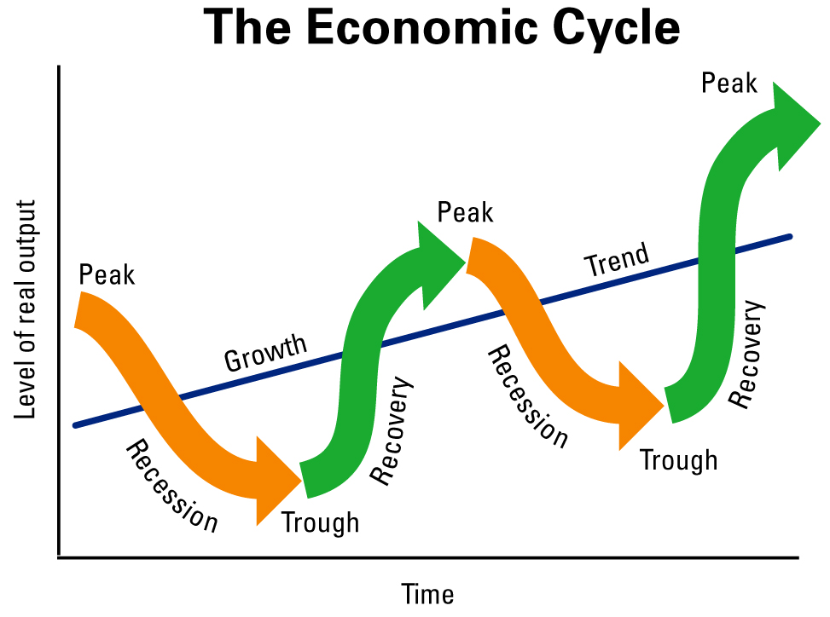
Business Cycle
Industry performance is related to the stage of the business cycle. What makes industry analysis challenging is that every business cycle is different and those who
look only at history miss the evolving trends that will determine future market performance.
Switching from one industry group to another over the course of a business cycle is known as a rotation strategy

Slide 22
Toward the end of recession
When the recession ends there will be an increase in loan demand, housing construction, and security offerings
Financial stocks rise in value because investors anticipate that banks’ earnings will rise as both the economy and loan demand recover
Brokerage houses become attractive investments because their sales and earnings are expected to rise as investors trade securities, businesses sell debt and equity, and there is an increase in mergers during the economic recovery

Slide 23
Early Stage of Recovery
Cyclical industries whose sales rise and fall along with general economic activity are attractive investments during economic recovery
Because of their high degree of operating leverage, which means that they benefit greatly from the sales increases during an economic expansion
Textile, Leather, Ceramic
Notes:
This means a small percentage change in sales can result in a large percentage change in operating income. (% change in EBIT/%change in sales)

Slide 24
At Recovery
A reviving economy increases consumer confidence and personal income
Consumer durable firms that produce expensive consumer items, such as cars, personal computers, refrigerators, air conditioner, smart phone, etc., become attractive investments
Once businesses recognize the economy is recovering, they begin to think about modernizing, renovating, or purchasing new equipment to satisfy rising demand and reduce costs.
Capital goods industries such as heavy equipment manufacturers, machine tool makers, and airplane manufacturers become attractive

Slide 25
Business Cycle Peak
The rate of inflation increases as demand starts to outstrip supply
Basic materials industries which transform raw materials into finished products, become investor favorites.
Oil, metals, timber
Inflation has little influence on the cost of extracting these products and they can increase prices, these industries experience higher profit margins

Slide 26
During Recession
Consumer staples outperform other sectors during a recession because, although overall spending may decline, people still spend money on necessities
Pharmaceuticals, food, and beverages
If a weak domestic economy causes a weak currency, industries with large export components to growing economies may benefit because their goods become more cost competitive in overseas markets

Slide 27
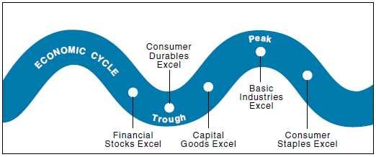

Slide 28
Investors should not invest based upon the current economic environment because the market has already incorporated current economic news into security prices
It is necessary to forecast important economic variables at least three to six months in the future and invest accordingly

Slide 29
Structural economic changes and alternative industries

Slide 30
Technology
Demand has fallen for carburetors on cars because of electronic fuel-injection technology. The engineering process has changed because of the advent of computer-aided design and computer-aided manufacturing
Perpetual improvement of designs in the semiconductor and microprocessor industry has made that industry a difficult one to evaluate
Advances in technology allow some plant sites and buildings to generate their own electricity, bypassing their need for power from the local electric utility
Trucks have reduced railroads’ market share in the long-distance carrier industry, and planes, not trains, now mainly carry people long distances
Changes in technology have spurred capital spending in technological equipment as firms try to use microprocessors and software as a means to gain competitive advantages.
Major retailers use bar-code scanning, which speeds the checkout process and allows the firm to track inventory. Use of customer credit cards allows firms to track customer purchases and send custom-made sales announcements

Slide 31
Politics and Regulation
Today’s social trend may be tomorrow’s law, regulation, or tax. The industry analyst needs to project and assess political changes relevant to the industry under study
Some regulations and laws are based on economic reasoning. Due to utilities’ positions as natural monopolies, their rates must be reviewed and approved by a regulatory body
Heavy regulation of an industry can result in increasing a firm’s costs and restricting entry into the industry.
Regulatory changes have affected numerous industries. Minimum-wage law for RMG
Regulations and laws affect international commerce. International tax laws, tariffs, quotas, embargoes, and other trade barriers affect different industries and global commerce in various ways. GSP for RMG

Slide 32
Evaluating The Industry Life Cycle

Slide 33
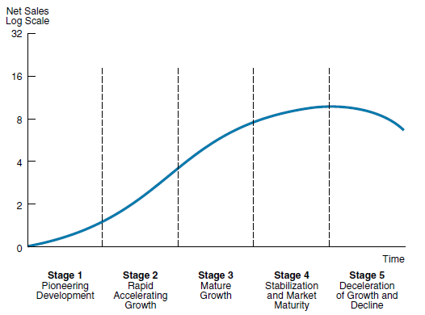
Life Cycle of an Industry

Slide 34
Life Cycle of an Industry
To estimate industry sales, you must predict the length of time for each stage.
“How long will an industry stay at each stage of life cycle?”
Provide some insights into profit margins and earnings growth
The profit margin series typically peaks very early in the total cycle and then levels off and declines as competition is attracted by the early success of the industry

Slide 35
Stage – 1: Pioneering Development
Start-up stage
Industry experiences modest sales growth
Very small or negative profit margins and profits
Market for the industry’s product/service is small
Firms involved incur major development costs

Slide 36
Stage – 2: Rapid Accelerating Growth
A market develops for the product or service and demand becomes substantial
The limited number of firms in the industry face little competition
The profit margins are very high
The industry builds its productive capacity as sales grow at an increasing rate as the industry attempts to meet excess demand
High sales growth and high profit margins that increase as firms become more efficient cause industry and firm profits to explode.

Slide 37
Stage – 3: Mature Growth
Future sales growth may be above normal but it no longer accelerates
If the overall economy is growing at 8 percent, sales for this industry might grow at an above normal rate of 15 percent to 20 percent a year

Slide 38
Stage – 3: Mature Growth
Rapid growth of sales and high profit margins attract competitors to the industry
Causes an increase in supply and lower prices
The profit margins begin to decline to normal levels

Slide 39
Stage – 4: Stabilization & Market Maturity
Probably the longest phase
Industry growth rate declines to the growth rate of the aggregate economy
Investors can estimate growth easily because sales correlate highly with an economic series
Sales grow in line with the economy but profit growth varies by industry because the competitive structure varies
Competition produces tight profit margins

Slide 40
Stage – 5: Deceleration of Growth and Decline
Industry’s sales growth declines because of shifts in demand or growth of substitutes
Profit margins continue to be squeezed, and some firms experience low profits or even losses
Firms that remain profitable may show very low rates of return on capital
Investors begin thinking about alternative uses for the capital tied up in this industry

Slide 41
Analysis of Industry Competition
Porter's Five Forces
HHI

Slide 42
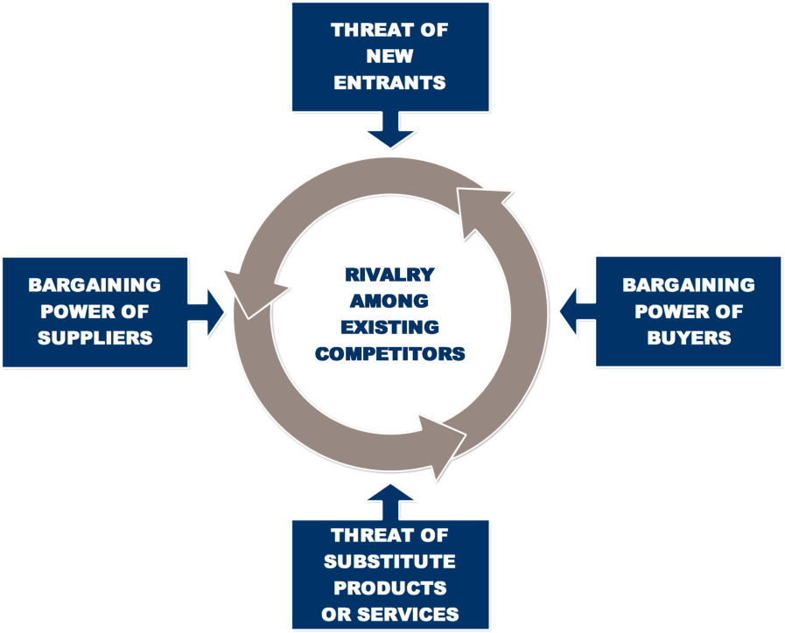
Porter's Five Forces

Slide 43
Threat of New Entrants
Bring new capacity
Prices, costs, rate of investment
New entrants
Gain market share
When new entrants are diversifying from other markets, they can leverage existing capabilities and cash flows to shake up competition
If entry barriers are low and newcomers expect little retaliation from the entrenched competitors, the threat of entry is high and industry profitability is moderated.

Slide 44
Barriers to Entry
Supply-side economies of scale
Arise when firms that produce at larger volumes enjoy lower costs per unit because they can spread fixed costs over more units
Demand-side benefits of scale
Arise in industries where a buyer’s willingness to pay for a company’s product increases with the number of other buyers who also patronize the company.
Customer switching costs
Switching costs are fixed costs that buyers face when they change suppliers

Slide 45
Barriers to Entry (cont’d)
Capital requirements
The need to invest large financial resources in order to compete can deter new entrants.
Unequal access to distribution channels
Sometimes access to distribution is so high a barrier that new entrants must bypass distribution channels altogether or create their own.
Restrictive government policy
Government policy can hinder or aid new entry directly, as well as amplify (or nullify) the other entry barriers.

Slide 46
Power of Suppliers
Powerful suppliers capture more of the value for themselves by charging higher prices, limiting quality or services, or shifting costs to industry participants.
Powerful suppliers, including suppliers of labor, can squeeze profitability out of an industry that is unable to pass on cost increases in its own prices

Slide 47
A supplier group is powerful if:
It is more concentrated than the industry it sells to.
The supplier group does not depend heavily on the industry for its revenues.
Switching costs in changing suppliers. For example, shifting suppliers is difficult if companies have invested heavily in specialized ancillary equipment or in learning how to operate a supplier’s equipment
Suppliers offer products that are differentiated. (Pharmaceutical)
There is no substitute for what the supplier group provides.

Slide 48
A supplier group is powerful if:
The supplier group can credibly threaten to integrate forward into the industry
In that case, if industry participants make too much money relative to suppliers, they will induce suppliers to enter the market

Slide 49
Power of Buyers
Powerful customers can capture more value by forcing down prices, demanding better quality or more service (thereby driving up costs)
Buyers are powerful if they have negotiating leverage relative to industry participants, especially if they are price sensitive, using their clout primarily to pressure price reductions.

Slide 50
A customer group is powerful if:
There are few buyers, or each one purchases in volumes that are large relative to the size of a single vendor.
The industry’s products are standardized or undifferentiated.
Buyers face few switching costs in changing vendors

Slide 51
A customer group is powerful if: (cont’d)
Buyers can credibly threaten to integrate backward and produce the industry’s product themselves if vendors are too profitable.
Generally intermediate customers

Slide 52
Threat of Substitutes
Substitute products or services limit an industry’s profit potential by placing a ceiling on prices.
If an industry does not distance itself from substitutes through product performance, marketing, or other means, it will suffer in terms of profitability—and often growth potential.

Slide 53
Threat of substitute is high if:
It offers an attractive price-performance trade-off to the industry’s product. The better the relative value of the substitute, the tighter is the lid on an industry’s profit potential
The buyer’s cost of switching to the substitute is low.

Slide 54
Rivalry among Existing Competitors
Rivalry among existing competitors takes many familiar forms, including price discounting, new product introductions, advertising campaigns, and service improvements
The degree to which rivalry drives down an industry’s profit potential depends, first, on the intensity with which companies compete and, second, on the basis on which they compete.
Competition on dimensions other than price is less likely to erode profitability because it improves customer value and can support higher prices.

Slide 55
The intensity of rivalry is greatest if:
Competitors are numerous or are roughly equal in size and power.
Industry growth is slow. Slow growth precipitates fights for market share.
Exit barriers are high.
Rivals are highly committed to the business and have aspirations for leadership, especially if they have goals that go beyond economic performance in the particular industry.
Firms cannot read each other’s signals well because of lack of familiarity with one another, diverse approaches to competing, or differing goals.

Slide 56
Price competition is most liable to occur if:
Products or services of rivals are nearly identical and there are few switching costs for buyers
Fixed costs are high and marginal costs are low.
The product is perishable.
Techno-product, Information, Hotel accommodation

Slide 57
Herfindahl-Hirschman Index - HHI
A commonly accepted measure of market concentration
It is calculated by squaring the market share of each firm competing in a market, and then summing the resulting numbers. The HHI number can range from close to zero to 10,000.
HHI < 100 indicates a highly competitive index. 100 < HHI < 1,500 indicates an unconcentrated index. 1500 < HHI < 2,500 indicates moderate concentration. HHI > 2,500 indicates high concentration
The U.S. Department of Justice uses the HHI for evaluating mergers.

Slide 58
Company Analysis

Slide 59
Growth Companies and Growth Stocks
Growth Companies
Growth Stocks
General definition – companies that consistently experience above-average increases in sales and earnings
Financial definition - A firm with the management ability and the opportunities to make investments that yield rates of return greater than the firm’s required rate of return
Growth stocks are not necessarily shares in growth companies
A stock with a higher rate of return than other stocks in the market with similar risk characteristics

Slide 60
Defensive Companies and Stocks
Defensive Companies
Defensive Stocks
Future earnings are likely to withstand an economic downturn
Relatively low business risk and not excessive financial risk.
Public utilities or grocery chains—firms that supply basic consumer necessities
Rate of return is not expected to decline during an overall market decline, or decline less than the overall market
A stock with low or negative systematic risk (a small positive or negative beta) may be considered a defensive stock
Notes:
Titas

Slide 61
Cyclical Companies and Stocks
Cyclical Companies
Cyclical Stocks
Sales and earnings will be heavily influenced by aggregate business activity
Ceramic, Steel, Auto, or heavy machinery industries will do well during economic expansions and poorly during economic contractions
Experience changes in its rates of return greater than changes in overall market rates of return.
High-beta stocks that have high correlation with the aggregate market and greater volatility
Notes:
RAK Ceramics

Slide 62
Speculative Companies and Stocks
Speculative Companies
Speculative Stocks
One whose assets involve great risk but that also has a possibility of great gain
Oil exploration firm
High probability of low or negative rates of return and a low probability of normal or high rates of return
Overpriced, high probability that during the future period when the market adjusts the stock price to its true value, it will experience either low or possibly negative rates of return.

Slide 63
Value Stocks
Appear to be undervalued for reasons other than earnings growth potential
Usually identified by analysts as having low price-earning or price-book value ratios
Notes:
Heidelberg, KPCL, Mpetroleum

Slide 64
Firm Competitive Strategies
Defensive Competitive Strategy - positioning the firm so that its capabilities provide the best means to deflect the effect of the competitive forces in the industry
Offensive Competitive Strategy - the firm attempts to use its strengths to affect the competitive forces in the industry
Notes:
Examples may include investing in fixed assets and technology to lower production costs or creating a strong brand image with increased advertising expenditures. Wal-Mart used its buying power to obtain price concessions from its suppliers.

Slide 65
Porter’s Competitive Strategies for Firms
Low-Cost Strategy
Differentiation Strategy
Cost advantages vary by industry and might include economies of scale, proprietary technology, or preferential access to raw materials.
Firm must command prices near the industry average, which means that it must differentiate itself
A firm seeks to identify itself as unique in its industry in an area that is important to buyers
Distribution system, Service
Notes:
Lafarge, Grameenphone

Slide 66
SWOT Analysis
Strengths and weaknesses involve identifying the firm’s internal abilities or lack thereof
Opportunities and threats include external situations, such as competitive forces, discovery and development of new technologies, government regulations, and domestic and international economic trends.

Slide 67
Strength
Good customer service
High-quality products
Strong brand image
Customer loyalty
Innovative R&D
Market leadership
Strong financial resources

Slide 68
Weakness
Weaknesses result when competitors have potentially exploitable advantages over the firm.
Once weaknesses are identified, the firm can select strategies to mitigate or correct the weaknesses
A firm with poor financial resources that would form joint ventures with financially stronger firms
Notes:
EBL, City Bank, GP-Internet

Slide 69
Opportunities
Shrinking competition
Favorable exchange rate shifts
Identification of a new market or product segment
Notes:
Janata Jute, GP-3G

Slide 70
Threats
Slowing domestic economy
Sluggish overseas economies for exporters
Additional government regulation
Notes:
Telecommunication – licensing fees

Slide 71
Favorable Attributes of Firms
The firm’s product is not faddish; it is one that consumers will continue to purchase over time
Have some long-run comparative competitive advantage over its rivals that is sustainable.
The firm’s industry or product has market stability. Market stability means less potential for entry.
The firm can benefit from cost reductions
Management/Directors are buying shares, which indicates that its insiders are putting their money into the firm
Notes:
Peter Lynch, the former portfolio manager of Fidelity Investments’ highly successful Magellan Fund. Computer Manufacturer-benefit from cost reductions

Slide 72
Tenets of Warren Buffett
Business Tenets
Is the business simple and understandable?
Does the business have a consistent operating history?
Does the business have favorable long-term prospects?
Notes:
BEXIMCO

Slide 73
Tenets of Warren Buffett
Management Tenets
Is management rational?
Is management candid with its shareholders?
Does management resist the institutional imperative?
Financial Tenets
Focus on return on equity, not earnings per share.
Calculate “owner earnings.”
Look for a company with relatively high profit margins for its industry.
Make sure the company has created at least one dollar of market value for every dollar retained.

Slide 74
Tenets of Warren Buffett
Market Tenets
What is the value of the business?
Can the business be purchased at a significant discount to its fundamental intrinsic value?

Slide 75
Investors should make use of research on
Competitive forces in an industry
Firm’s responses to those forces
SWOT analysis
Lynch’s suggestions
Buffet’s tenets

