Slide 1


Slide 2
Financial Literacy
Knowledge and skills about personal planning and management of income and savings.
Basic understanding to assess the suitability of various financial products and investment opportunities available in the financial markets.
Awareness and ideas about access to financial services and availability of various types of products and their features.
Understanding consumers rights and obligations, risk and return potentials related to investments opportunities.
Changed attitude to translate knowledge into responsible financial behavior.

Slide 3
Why Financial Literacy?
Ensuring self-protection from financial frauds.
Building a financially secured future.
Preparing for emergencies by incorporating contingencies in financial plan.
Making an individual more responsible with a disciplined approach to money.
Understanding alternative financial products, their risks and returns.
Understanding basic financial concepts.
Developing skills and confidence.

Slide 4
Ignorant investors’ common behavior
Invest without proper knowledge and assessment about the risks of financial markets and products.
Invest in risky products for utopian abnormal benefits.
Invest without assessing own capacity and risk bearing ability.
Speculative and rumor-based decision making and investment without proper analysis.
Invest in high market price and panicky divest when price declines.
Take high cost debt without assessing repayment ability.
No specific plan of savings and investment.
Invest all in a single or similar product.
Attitude to follow big investors.
Herd behavior.
Invest without searching for alternatives.

Slide 5
As a result
1
Investors incur losses
2
Get frustration
3
Turn back from financial markets
2
2
2
2
Develop consumerism
Forgo savings habits
Financial markets suffer and become illiquid
Negative Impact on economy

Slide 6
To overcome
Educate them about financial investment, markets and products
Help to change their attitude and way of thinking
Make them aware about risks and returns
Build them up to make own decisions
Increase their analytical ability
Prepare them to think about secured future
Give investors the right direction

Slide 7
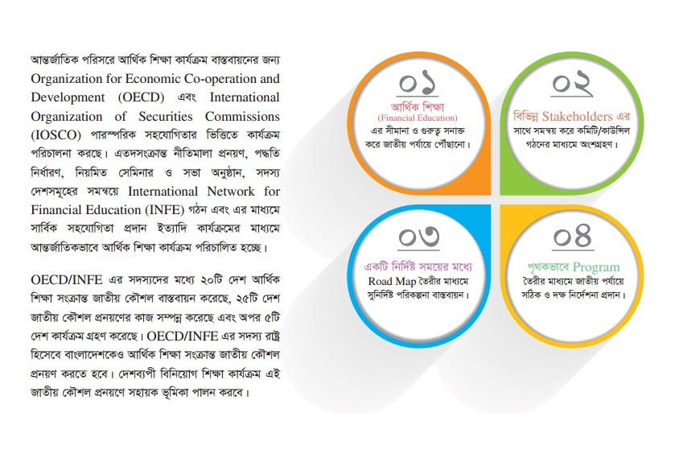

Slide 8
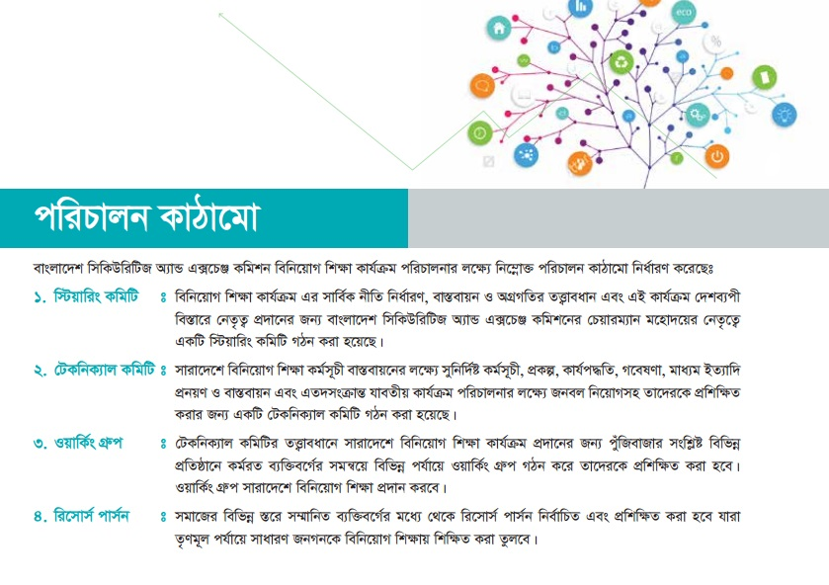

Slide 9
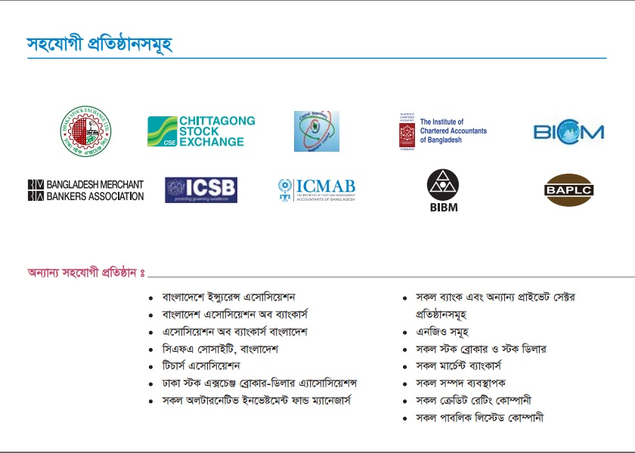

Slide 10
Individuals
Government
FIs
Savings institutions
Financial
Literacy
Financial
Sector
Regulators
FIs-
Intermediaries
NGOs
Educational
Institutions

Slide 11
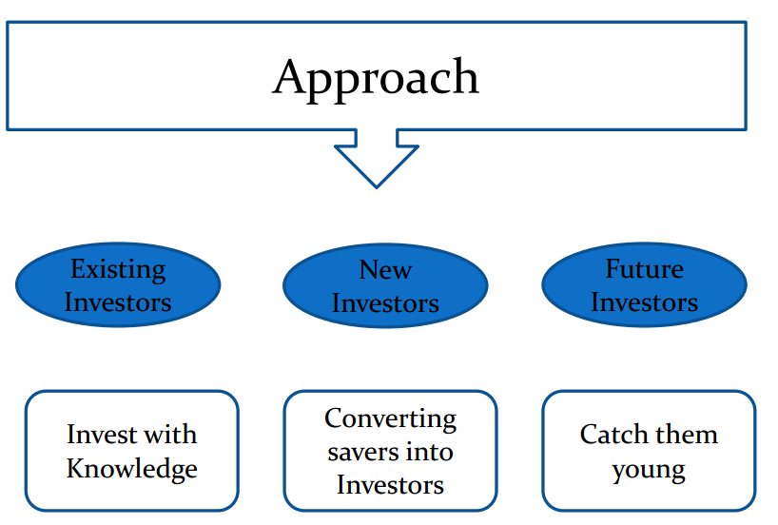

Slide 12
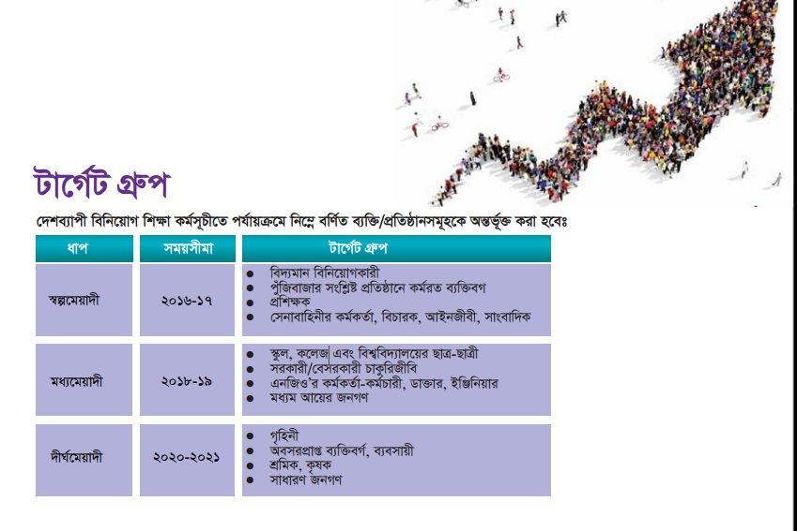

Slide 13
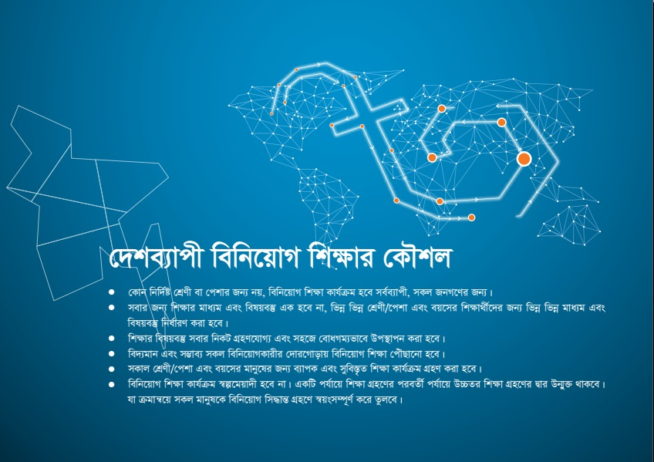

Slide 14
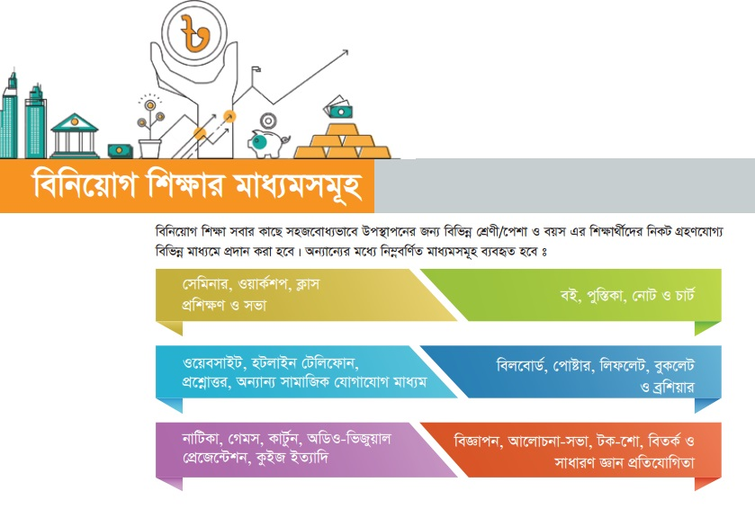

Slide 15
Product
Education
Sector Based
Financial Education
Basic Financial Literacy

Slide 16
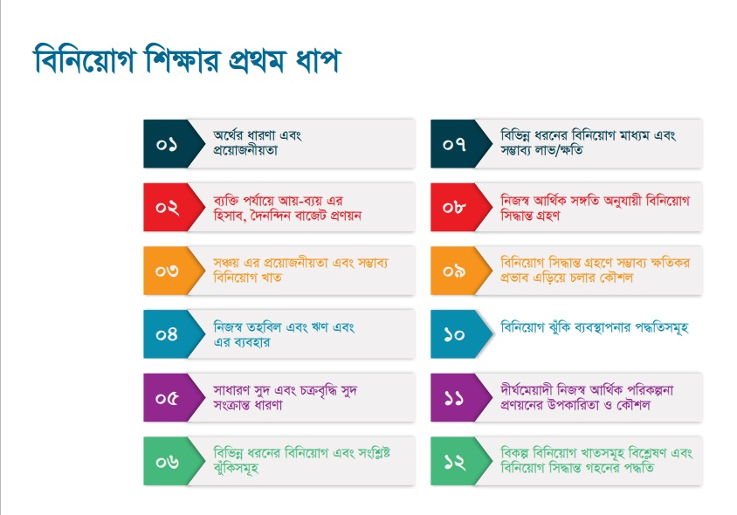

Slide 17
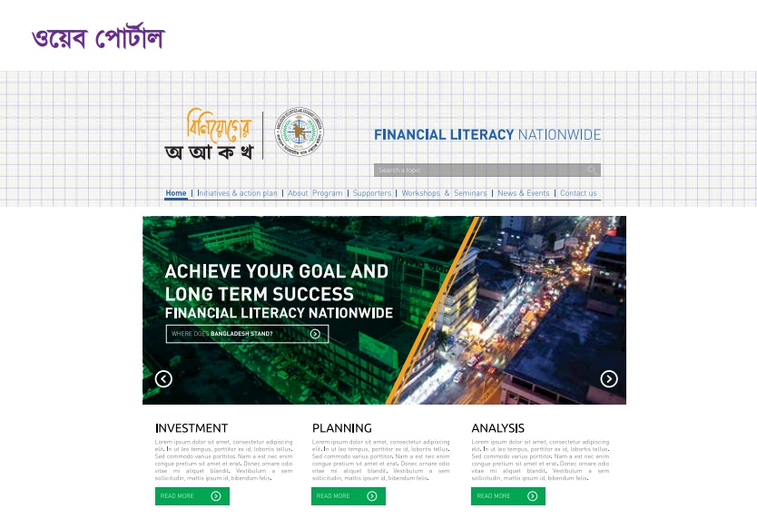

Slide 18
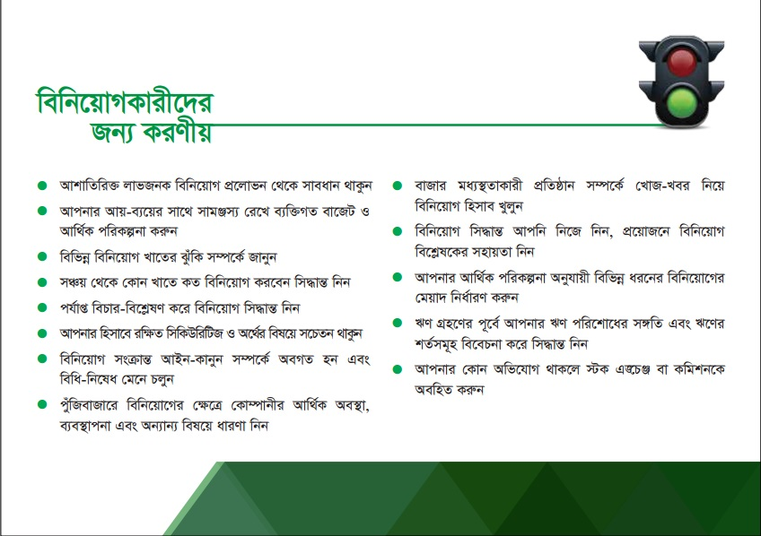
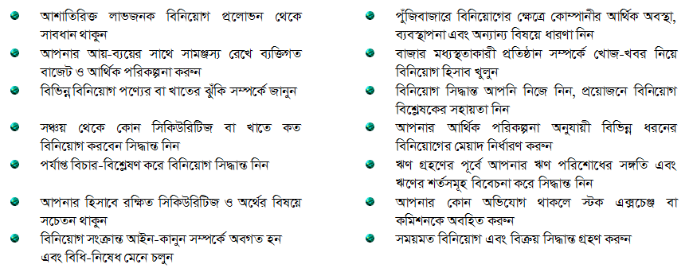

Slide 19
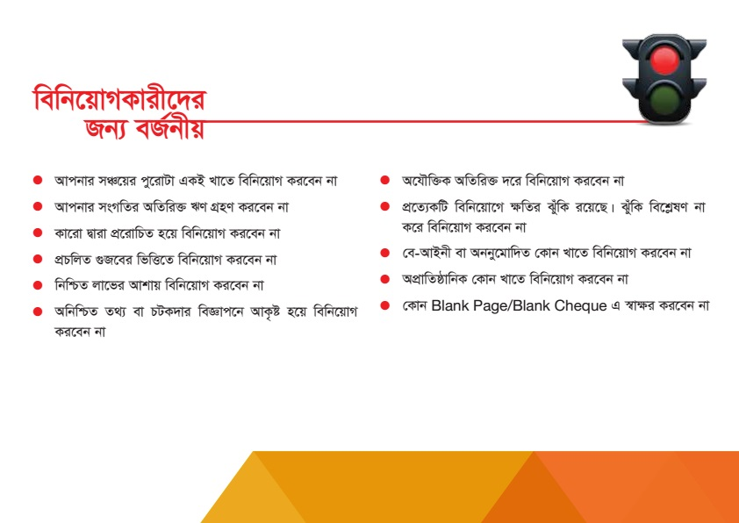
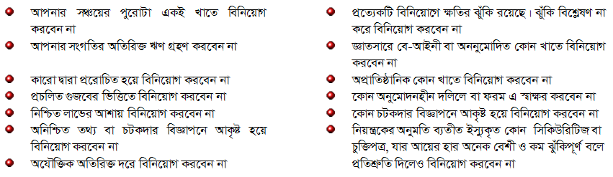

Slide 20
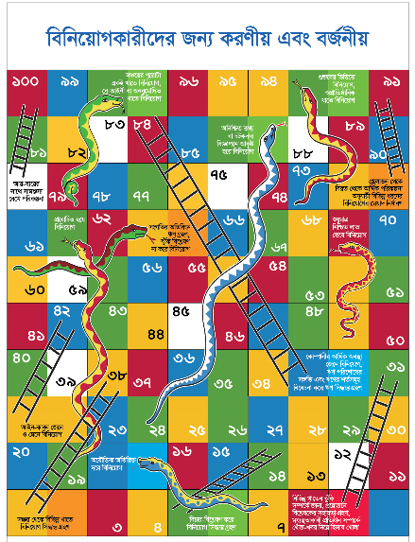

Slide 21
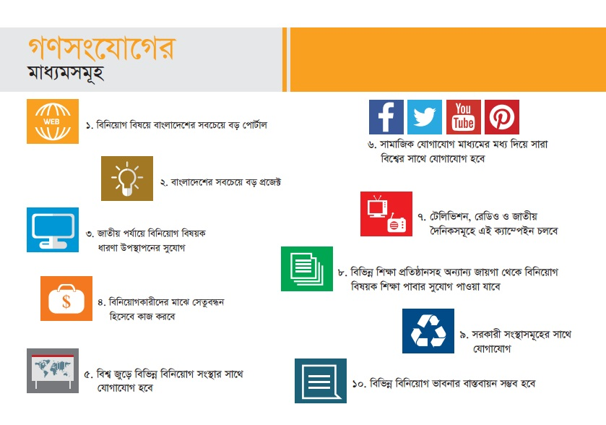

Slide 22
Training Flow
Workshop for Master Trainers
Training of Trainers by Master Trainers
Training to Target Groups

Slide 23


