Slide 1
Investment basics
Two generic types of investment strategies – Fundamental analysis and technical analysis
In fundamental analysis, we try to determine the intrinsic value of a share – value that should incur
In technical analysis, we try to track the future value of a share – value which is expected to incur
So, without even knowing the firm’s name we can trade and garner profit.

Slide 2
Investment basics – continued
In fundamental analysis – we use the available financial statement data, our conceptions about industry, macro-economy, firm specific issues to derive the value.
On the other hand, in technical analysis – we just need the price data and volume data.
In fundamental analysis – we often use a lot of subjective assumptions.
Technical analysis is very precise and very objective.
So, technical analysis is less time-consuming and more concrete

Slide 3
Investment basics – continued
Good companies are not always good purchase
Bad companies can be good purchases.
So, timing is at times more important than value

Slide 4
Technical analysis – premises
History repeats – same is the case with price patterns and trends
Only and only demand and supply affects the stock price is a highly restrictive assumption of fundamental analysis
The market is a liquid one is a restrictive assumption of fundamental analysis as well
So, DSE may not be the appropriate place for technical analysis, but do we have options?

Slide 5
A general framework for technical analysis
Step 1: Adjust the data; for example use return series instead of a raw price data
Step 2 : Test of randomness in the data set; for example test the data set for ARIMA (0,1,0), or run test
Step 3: Use technical indicators provided the return series is non-random. Do a diagnosis test to check the extent, direction and strength of the trend through ADX, + DI, - DI and ATR
Step 4: Use lagging indicators like Moving average or MACD for trending data; use leading indicators like RSI, William’s R for trading data
Step 5: Use volume based indicators like OBV, NBV or MFI for convergence and divergence
Step 6: Look out for the existing bigger pattern and cycle – reversal, continuation, flat
Step 7: Use candlestick patterns before final buy or sell decision

Slide 6
Step one – Data adjustment
Objective 1 – Getting the relative measurement; not the absolute one
Objective 2 – Getting smoothed data set

Slide 7
Step two – Testing randomness
Method – ARIMA (0,1,0)
ARIMA (a dynamic time series model) will be used to check whether the return series depends on the past values of the return series and past disturbance elements. The model is generally referred to as an ARIMA (p, d, q) model where p, d, and q are integers greater than or equal to zero and refer to the order of the autoregressive, integrated, and moving average parts of the model respectively.
Autoregressive orders (AR) - specify which previous values from the series are used to predict current values.
Difference (I) - Specifies the order of differencing applied to the series before estimating models.
Moving average (MA) orders specify how deviations from the series mean for previous values are used to predict current values.
Null hypothesis – Data set is not random
Level of significance – 5% generally

Slide 8
Step three – Testing trend existence, direction and strength
Trend existence checking – ADX or generally time-series based regression
Null hypothesis – The trend co-efficient is zero
Level of significance – 5% generally
Trend direction – The level of +DI and –DI or the sign of trend co-efficient
Trend strength – ATR is the best method; but standard deviation or beta can also be used to depict the volatility

Slide 9
Step four - Revisiting the learning about indicators
Based on the order of differencing applied to the price series make a choice among SMA, EMA, DEMA and TEMA
Based on the noisy part – consider the relevance of DisMA
Look out for volatilities and get your own range while using RSI, MFI, William R or stochastic oscillators
Use two or three signaling bands while using Bollinger Band, Ketlner Band or Envelop band
Do not forget the implications for sentiment indicators
Change in polarity ????

Slide 10
Step five – Volume based indicators
Volume based indicators like OBV – on balance volume can be used to confirm a trend, to pick up bullish divergences or bearish divergences.
Price often follows the volume

Slide 11
Technical analysis – theory
Dow theory: Three simultaneous market movements – major trend, medium swing and minor adjustment
Elliott wave theory: Market cycles are composed of impulse waves and corrective waves. Usually 4 impulses and 4 corrective impulses take place sequentially.
So, do not panic – price fall can just be a part of the cycle.

Slide 12
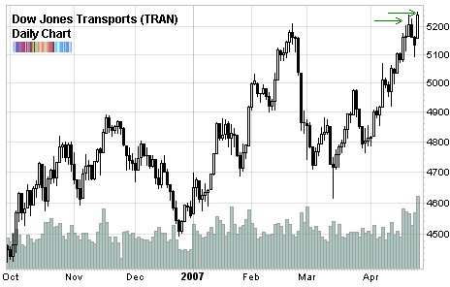
Dow theory
Major movement
Secondary downward movement
Secondary upward movement

Slide 13
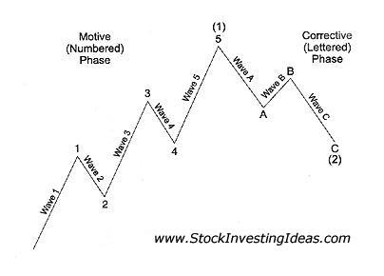
Elliott wave theory

Slide 14
Technical analysis – chart
Line chart – presents stock prices with respect to time
Scaled chart – presents price changes not the absolute price with respect to time
Point and figure chart – only significant days matter, noises are eliminated
Candlestick chart – represents inter-day price volatility
Relative strength analysis – a depiction of relative performance with respect to time
So, the traditional charts may not be the best way to understand the market dynamics.

Slide 15
Candlestick chart basic
The hollow or filled portion of the candlestick is called “the body” (also referred to as “the real body”). The long thin lines above and below the body represent the high/low range and are called “shadows” (also referred to as “wicks” and “tails”). The high is marked by the top of the upper shadow and the low by the bottom of the lower shadow. If the stock closes higher than its opening price, a hollow candlestick is drawn with the bottom of the body representing the opening price and the top of the body representing the closing price. If the stock closes lower than its opening price, a filled candlestick is drawn with the top of the body representing the opening price and the bottom of the body representing the closing price.

Slide 16
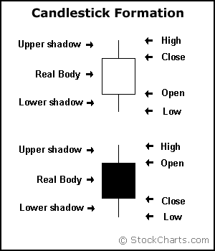
Candlestick chart basic

Slide 17
Candlestick chart basic
Long white candlesticks show strong buying pressure. The longer the white candlestick is, the further the close is above the open. This indicates that prices advanced significantly from open to close and buyers were aggressive. While long white candlesticks are generally bullish, much depends on their position within the broader technical picture. After extended declines, long white candlesticks can mark a potential turning point or support level. If buying gets too aggressive after a long advance, it can lead to excessive bullishness.
Long black candlesticks show strong selling pressure. The longer the black candlestick is, the further the close is below the open. This indicates that prices declined significantly from the open and sellers were aggressive. After a long advance, a long black candlestick can foreshadow a turning point or mark a future resistance level. After a long decline a long black candlestick can indicate panic or capitulation.

Slide 18
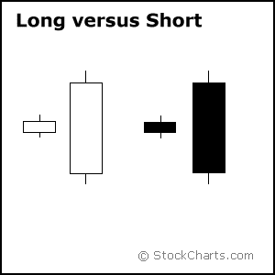
Candlestick chart basic

Slide 19
Marubozu brothers
Marubozu do not have upper or lower shadows and the high and low are represented by the open or close. A White Marubozu forms when the open equals the low and the close equals the high. This indicates that buyers controlled the price action from the first trade to the last trade. Black Marubozu form when the open equals the high and the close equals the low. This indicates that sellers controlled the price action from the first trade to the last trade.

Slide 20
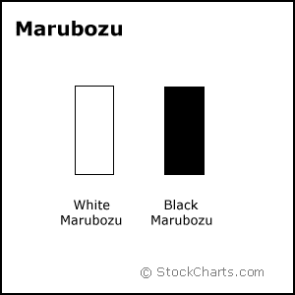
Marubozu brothers

Slide 21
Long Versus Short Shadows
The upper and lower shadows on candlesticks can provide valuable information about the trading session. Upper shadows represent the session high and lower shadows the session low. Candlesticks with short shadows indicate that most of the trading action was confined near the open and close. Candlesticks with long shadows show that prices extended well past the open and close.
Candlesticks with a long upper shadow and short lower shadow indicate that buyers dominated during the session, and bid prices higher. However, sellers later forced prices down from their highs, and the weak close created a long upper shadow. Conversely, candlesticks with long lower shadows and short upper shadows indicate that sellers dominated during the session and drove prices lower. However, buyers later resurfaced to bid prices higher by the end of the session and the strong close created a long lower shadow.

Slide 22
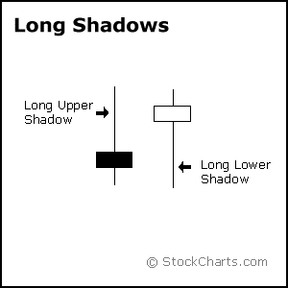
Long Versus Short Shadows

Slide 23
Spinning tops
Candlesticks with a long upper shadow, long lower shadow and small real body are called spinning tops. One long shadow represents a reversal of sorts; spinning tops represent indecision. The small real body (whether hollow or filled) shows little movement from open to close, and the shadows indicate that both bulls and bears were active during the session. Even though the session opened and closed with little change, prices moved significantly higher and lower in the meantime. Neither buyers nor sellers could gain the upper hand and the result was a standoff. After a long advance or long white candlestick, a spinning top indicates weakness among the bulls and a potential change or interruption in trend. After a long decline or long black candlestick, a spinning top indicates weakness among the bears and a potential change or interruption in trend.

Slide 24
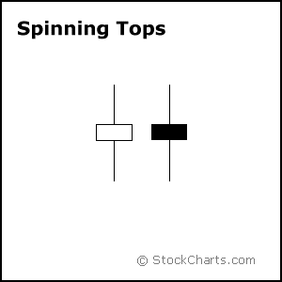
Spinning tops

Slide 25
Doji
Doji are important candlesticks that provide information on their own and as components of in a number of important patterns. Doji form when a security's open and close are virtually equal. The length of the upper and lower shadows can vary and the resulting candlestick looks like a cross, inverted cross or plus sign. Alone, doji are neutral patterns. Any bullish or bearish bias is based on preceding price action and future confirmation. The word “Doji” refers to both the singular and plural form. deally, but not necessarily, the open and close should be equal. While a doji with an equal open and close would be considered more robust, it is more important to capture the essence of the candlestick. Doji convey a sense of indecision or tug-of-war between buyers and sellers. Prices move above and below the opening level during the session, but close at or near the opening level. The result is a standoff. Neither bulls nor bears were able to gain control and a turning point could be developing.

Slide 26
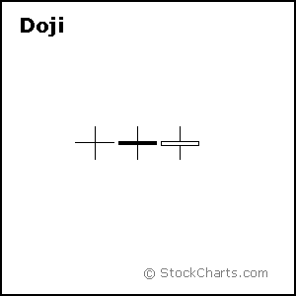
Doji

Slide 27
Dragon Fly Doji
Dragon fly doji form when the open, high and close are equal and the low creates a long lower shadow. The resulting candlestick looks like a “T” with a long lower shadow and no upper shadow. Dragon fly doji indicate that sellers dominated trading and drove prices lower during the session. By the end of the session, buyers resurfaced and pushed prices back to the opening level and the session high.
The reversal implications of a dragon fly doji depend on previous price action and future confirmation. The long lower shadow provides evidence of buying pressure, but the low indicates that plenty of sellers still loom. After a long downtrend, long black candlestick, or at support, a dragon fly doji could signal a potential bullish reversal or bottom. After a long uptrend, long white candlestick or at resistance, the long lower shadow could foreshadow a potential bearish reversal or top. Bearish or bullish confirmation is required for both situations.

Slide 28
Gravestone Doji
Gravestone doji form when the open, low and close are equal and the high creates a long upper shadow. The resulting candlestick looks like an upside down “T” with a long upper shadow and no lower shadow. Gravestone doji indicate that buyers dominated trading and drove prices higher during the session. However, by the end of the session, sellers resurfaced and pushed prices back to the opening level and the session low.
As with the dragon fly doji and other candlesticks, the reversal implications of gravestone doji depend on previous price action and future confirmation. Even though the long upper shadow indicates a failed rally, the intraday high provides evidence of some buying pressure. After a long downtrend, long black candlestick, or at support, focus turns to the evidence of buying pressure and a potential bullish reversal. After a long uptrend, long white candlestick or at resistance, focus turns to the failed rally and a potential bearish reversal. Bearish or bullish confirmation is required for both situations.

Slide 29
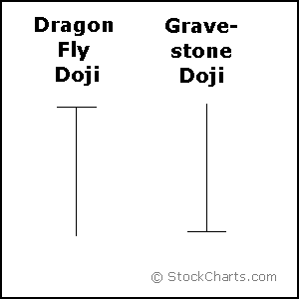
Dragon Fly & Gravestone DojI

Slide 30
Technical analysis – support and resistance
Without any fundamental change, stock price generally move within a range.
Support level – a price range sufficient to stop price decline
Resistance level - a price range sufficient to stop price hike
Change in polarity – when the band is breached, support level becomes the resistance level and resistance level becomes the support level
So, index cannot go below 4000 – we are actually referring to the support level or index could not go above 9000 – we were actually referring to resistance level in 2010.

Slide 31
Technical analysis – understanding trend
A mere shortfall or mere enhancement does not constitute a downtrend or a uptrend
In case of significant uptrend – each subsequent new high is higher than the prior high
In case of significant uptrend – each subsequent retrenchment is a higher low than the prior low
In case of significant downtrend – there will be lower lows and lower highs
So, most often we fail to distinguish between trend and adjustments.

Slide 32
Technical analysis – reversal pattern
Head and shoulders pattern – a uptrend followed by a downtrend
Inverse Head and shoulders pattern – a downtrend followed by a uptrend
There can be multiple tops or bottoms
So, pick up pattern earlier and you are actually hitting the bull’s eye

Slide 33
General framework for reversal pattern
Test the level of autocorrelation
Data should be mean-reverting
A mean reverting data set’s autocorrelation level will approximate to zero after three to four lags
Seasonality even though it is not a reversal pattern can prove out to be handful

Slide 34
Head and shoulders pattern
Head and Shoulders formation consists of a left shoulder, a head, and a right shoulder and a line drawn as the neckline.
The left shoulder is formed at the end of an extensive move during which volume is noticeably high. After the peak of the left shoulder is formed, there is a subsequent reaction and prices slide down to a certain extent which generally occurs on low volume. The prices rally up to form the head with normal or heavy volume and subsequent reaction downward is accompanied with lesser volume.
The right shoulder is formed when prices move up again but remain below the central peak called the Head and fall down nearly equal to the first valley between the left shoulder and the head or at least below the peak of the left shoulder. Volume is lesser in the right shoulder formation compared to the left shoulder and the head formation.
A neckline is drawn across the bottoms of the left shoulder, the head and the right shoulder. When prices break through this neckline and keep on falling after forming the right shoulder, it is the ultimate confirmation of the completion of the Head and Shoulders Top formation

Slide 35
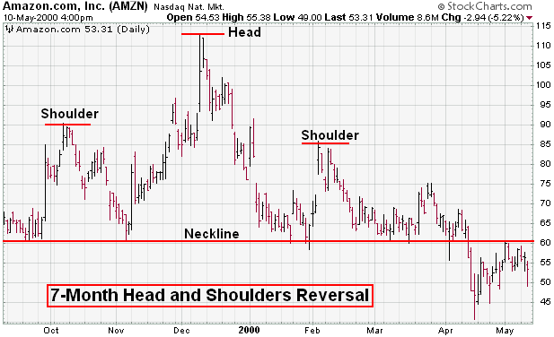
Head and shoulders pattern

Slide 36
Inverse Head and shoulders pattern
This pattern is identified when the price action of a security meets the following characteristics:
1. The price falls to a trough and then rises.
2. The price falls below the former trough and then rises again.
3. Finally, the price falls again, but not as far as the second trough.
Once the final trough is made, the price heads upward toward the resistance found near the top of the previous troughs. Investors typically enter into a long position when the price rises above the resistance of the neckline. The first and third trough are considered shoulders, and the second peak forms the head.

Slide 37
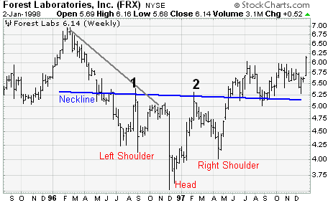
Inverse Head and shoulders pattern

Slide 38
Double top pattern
The Double Top Reversal is a bearish reversal pattern typically found on bar charts, line charts and candlestick charts. As its name implies, the pattern is made up of two consecutive peaks that are roughly equal, with a moderate trough in-between.

Slide 39
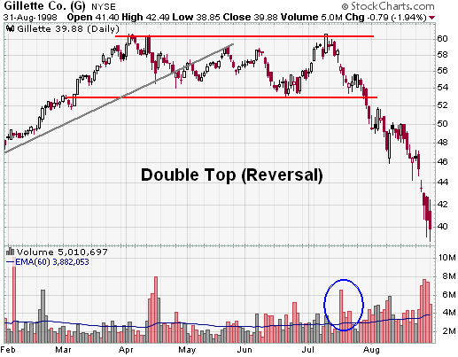
Double top pattern

Slide 40
Double bottom pattern
The Double Bottom Reversal is a bullish reversal pattern typically found on bar charts, line charts and candlestick charts. As its name implies, the pattern is made up of two consecutive troughs that are roughly equal, with a moderate peak in-between.

Slide 41
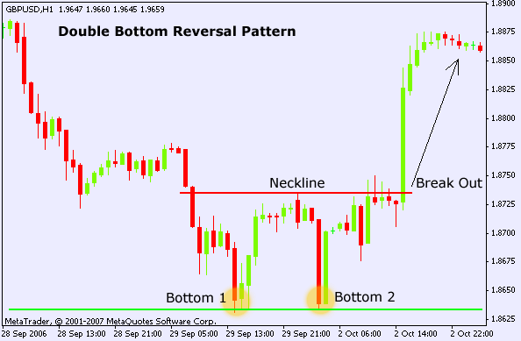
Double bottom pattern

Slide 42
Triple top pattern
A pattern used in technical analysis to predict the reversal of a prolonged uptrend. This pattern is identified when the price of an asset creates three peaks at nearly the same price level. The bounce off the resistance near the third peak is a clear indication that buying interest is becoming exhausted. It is used by traders to predict the reversal of the uptrend.

Slide 43
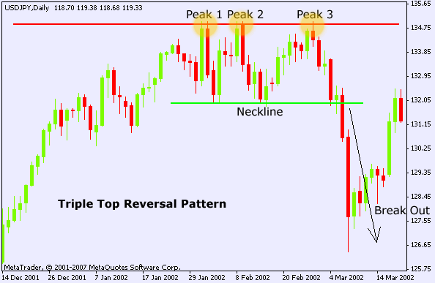
Triple top pattern

Slide 44
Triple bottom pattern
A pattern used in technical analysis to predict the reversal of a prolonged downtrend. The pattern is identified when the price of an asset creates three troughs at nearly the same price level. The third bounce off the support is an indication that buying interest (demand) is outweighing selling interest (supply) and that the trend is in the process of reversing.

Slide 45
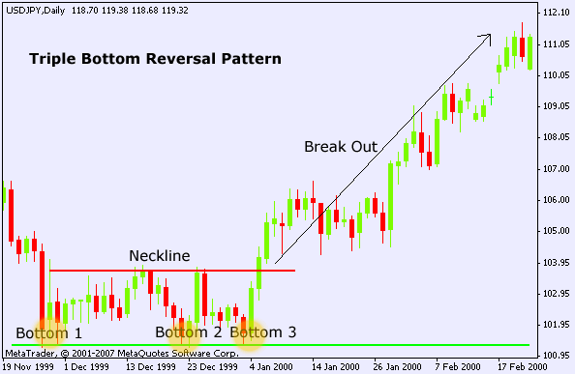
Triple bottom pattern

Slide 46
Technical analysis – continuation pattern
Here a uptrend will be followed by a uptrend
Here a downtrend will be followed by a downtrend
Continuation patterns can look like triangle, rectangle, flag and pennants.
So, once again pick up pattern earlier and you are actually hitting the bull’s eye

Slide 47
Continuation pattern
A Continuation pattern is used to predict the resumption of a market trend that was in place prior to the formation of a pattern . For example , there may be upward trend in price , now with that upward trend in place , a new pattern is identified , that pattern will confirm that the upward trend that was in place is expected to continue. Triangular pattern is common continuation pattern . It comes in 3 forms
1. Ascending triangle : Here there will be 2 trend line , a trend line connecting high prices is horizontal and another trend line connecting low price is upward . It means that every time price reaches at point ( high price) , sellers continue selling so that price will not go up beyond that price level , but every buyers continue to buy and getting more and more bullish as a result every new low price is higher that the prior low price . Once group who keep selling around a same high price level is replaced by a new group of buyers , and rally continues beyond the triangle is a bullish or buy signal
2.Descending triangle : Here there will be 2 trend line , a trend line connecting low prices is horizontal and another trend line connecting high price is downward trend . This is just the opposite of Ascending triangle and rally continues beyond the triangle is a bearish or sale signal.
3. Symmetrical triangle : Here trend line formed by the high price slopes downward and the trend line formed by the low prices is slopes upward and finally two trend line meets at roughly same point forming a symmetrical triangle. Because sellers are dominated by long term investors and the pressure to sell diminishes once the sellers have sold their security . Thus the pattern ends in the same direction as the trend that preceded it . For example before forming this symmetrical pattern , if there was a upward trend , it means that once symmetrical pattern is detected , that upward trend will again continue to exist.

Slide 48
General framework for continuation pattern
Check out whether the data set is trending or not
Again ADX or a basic time-series based regression will prove out to be handy

Slide 49
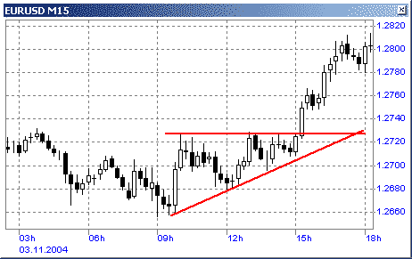
Ascending triangle

Slide 50
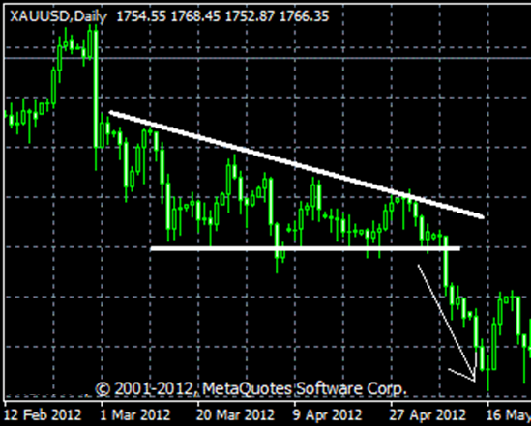
Descending triangle

Slide 51
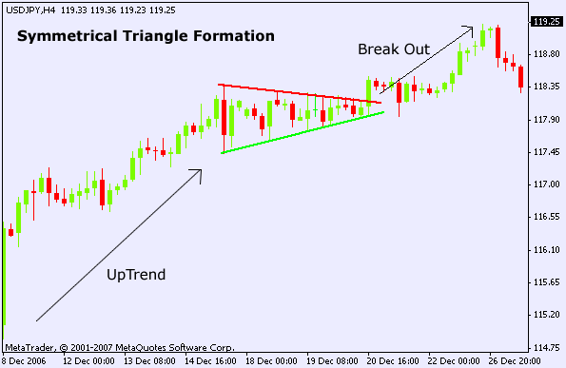
Symmetrical triangle

Slide 52
Continuation pattern
A Rectangle is a continuation pattern that forms as a trading range during a pause in the trend. The pattern is easily identifiable by two comparable highs and two comparable lows. The highs and lows can be connected to form two parallel lines that make up the top and bottom of a rectangle.

Slide 53
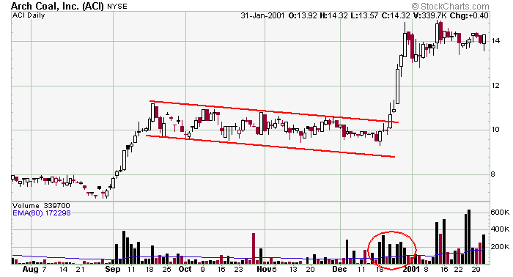
Bullish rectangular pattern

Slide 54
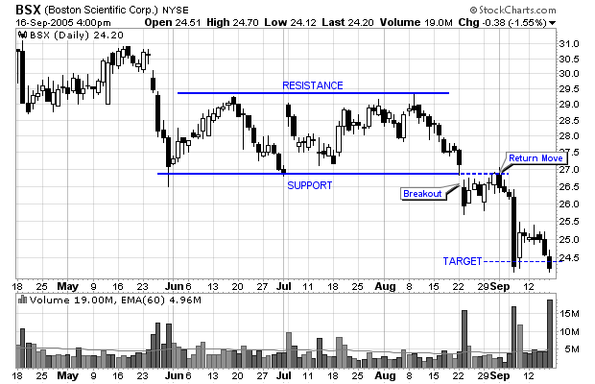
Bearish rectangular pattern

Slide 55
Technical analysis – investment strategy
Moving average: Moving average is the average price of a security over a set amount of time. By plotting a security's average price, the price movement is smoothed out. Once the day-to-day fluctuations are removed, traders are better able to identify the true trend and increase the probability that it will work in their favor.
Simple Moving Average : This is the most common method used to calculate the moving average of prices. It simply takes the sum of all of the past closing prices over the time period and divides the result by the number of prices used in the calculation. For example, in a 10-day moving average, the last 10 closing prices are added together and then divided by 10
Exponential Moving Average : This moving average calculation uses a smoothing factor to place a higher weight on recent data points and is regarded as much more efficient than the linear weighted average. The most important thing to remember about the exponential moving average is that it is more responsive to new information relative to the simple moving average. This responsiveness is one of the key factors of why this is the moving average of choice among many technical traders.
Moving average conveys important information about prices. A rising moving average shows that prices are generally increasing. A falling moving average indicates that prices, on average, are falling. A rising long-term moving average reflects a long-term uptrend. A falling long-term moving average reflects a long-term downtrend.

Slide 56
Technical analysis – investment strategy
Golden cross – When the short-term moving average line crosses the long-term moving average line from below , that crossover is known as golden cross. It indicates bullish market and one should purchase.
Dead cross - When the short-term moving average line crosses the long-term moving average line from above , that crossover is known as dead cross. It indicates bearish market and one should sell.

Slide 57
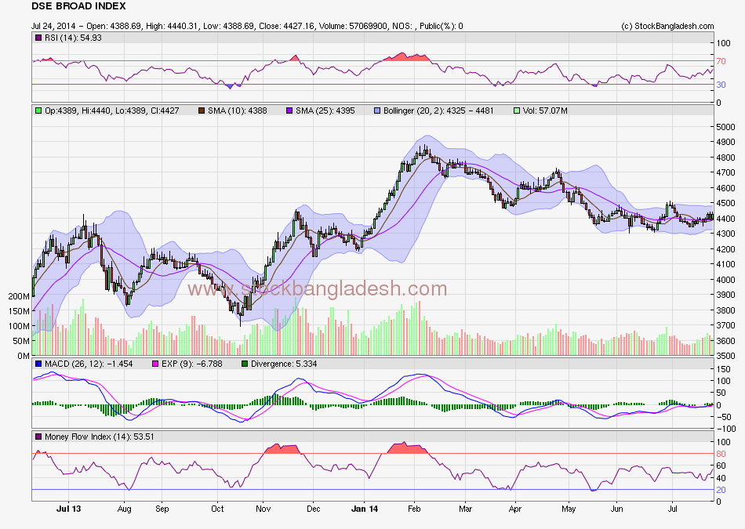
Moving average – Simple average
Golden cross
Dead cross
Dead cross
Golden cross

Slide 58
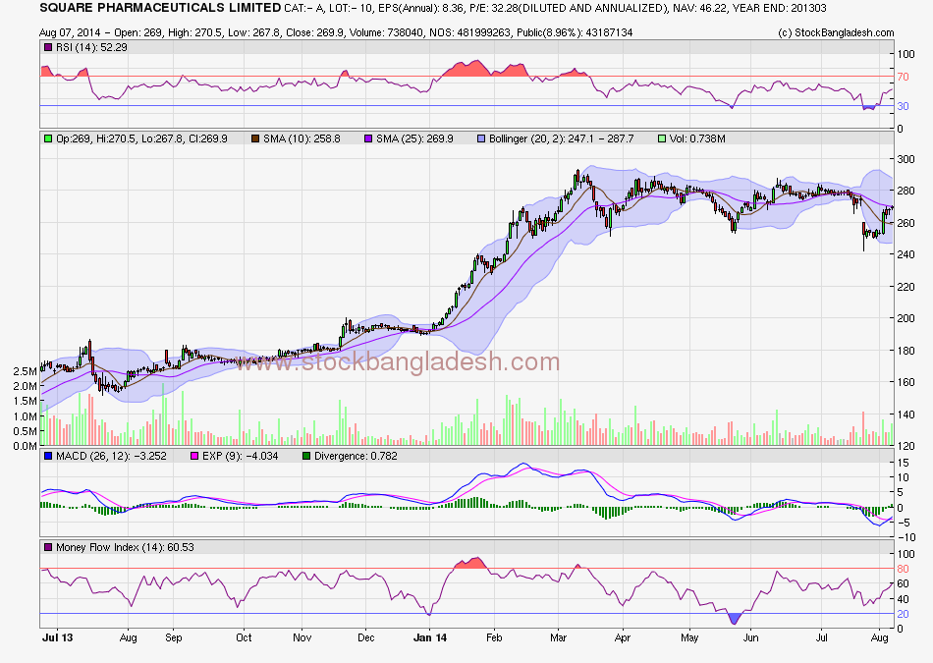
Moving Average – Simple average
Golden cross
Golden cross
Dead cross
Dead cross

Slide 59
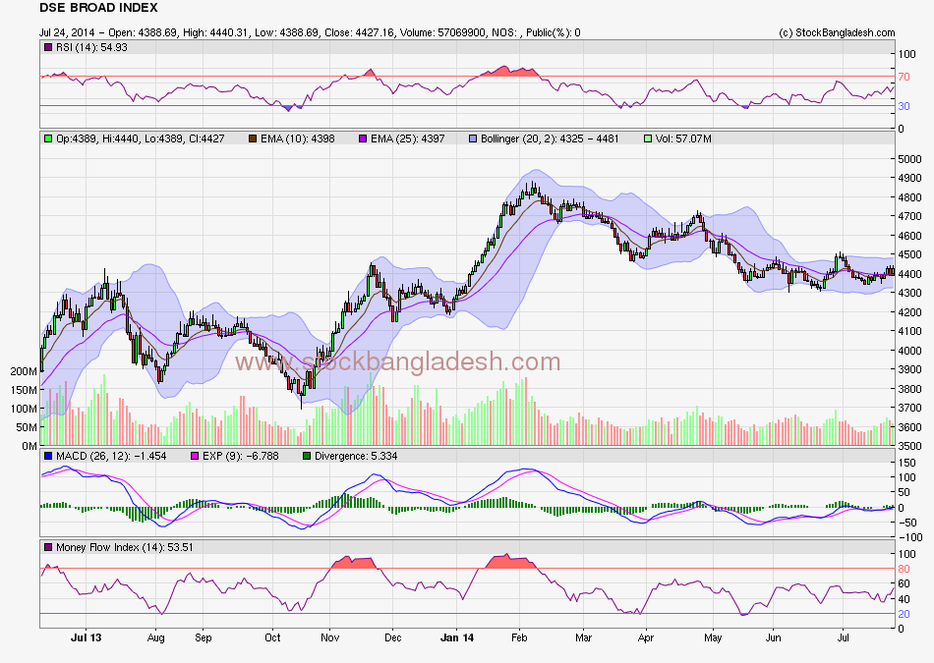
Moving average – Exponential moving average
Dead cross
Golden cross
Dead cross
Golden cross

Slide 60
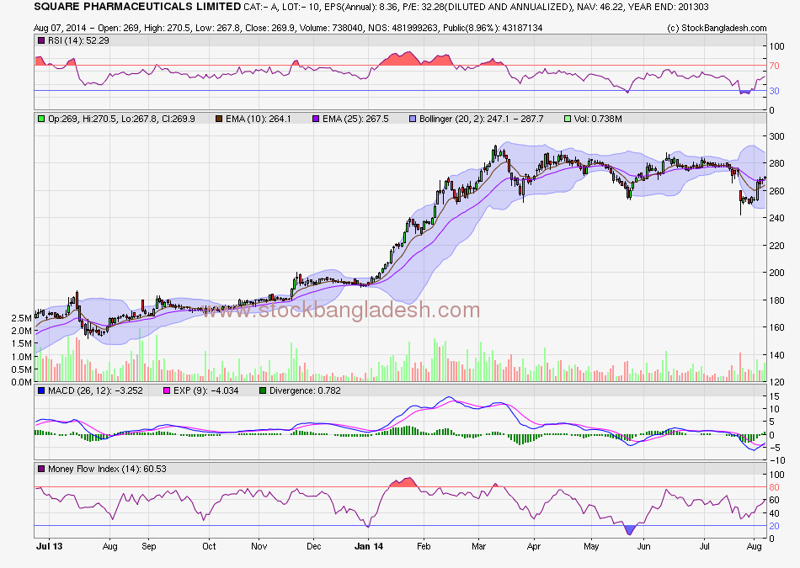
Moving average – Exponential moving average
Dead cross
Golden cross
Golden cross
Dead cross

Slide 61
Technical analysis – investment strategy
RSI: It measures the speed and change of price movements. RSI oscillates between zero and 100. Traditionally, and according to Wilder, RSI is considered overbought when above 70 and oversold when below 30. Signals can also be generated by looking for divergences, failure swings and centerline crossovers. It is calculated as
RSI = 100 - 100/(1 + RS*)
*Where RS = Average of x days' up closes / Average of x days' down close. RSI calculation is based on 14 periods, which is the default suggested by Wilder in his book.
Significantly less than 30 – indicates an oversold scenario and one should purchase.
Significantly more than 70 - indicates an overbought scenario and one should sell.

Slide 62
RSI
RSI > 70
RSI < 30
RSI > 70
RSI < 30

Slide 63
RSI
RSI > 70
RSI > 70
RSI < 30
RSI < 30

Slide 64
Technical analysis – investment strategy continued
MFI: An oscillator that uses both price and volume to measure buying and selling pressure. MFI is also known as volume-weighted RSI. MFI starts with the typical price for each period. Money flow is positive when the typical price rises (buying pressure) and negative when the typical price declines (selling pressure). A ratio of positive and negative money flow is then plugged into an RSI formula to create an oscillator that moves between zero and one hundred.
Calculation of MFI
* 1. Typical Price = (High + Low + Close)/3
2. Raw Money Flow = Typical Price x Volume
* 3. Money Flow Ratio = (14-period Positive Money Flow)/(14-period Negative Money Flow)
* 4. Money Flow Index = 100 - 100/(1 + Money Flow Ratio)
Significantly less than 20 – indicates an oversold scenario and one should purchase.
Significantly more than 80 - indicates an overbought scenario and one should sell.

Slide 65
MFI
MFI > 80
MFI < 20
MFI > 80
MFI < 20

Slide 66
MFI
MFI < 30
MFI > 70
MFI < 30

Slide 67
Technical analysis – investment strategy continued
MACD oscillator: turns two trend-following indicators, moving averages, into a momentum oscillator by subtracting the longer moving average from the shorter moving average. As a result, the MACD offers the best of both worlds: trend following and momentum. The MACD fluctuates above and below the zero line as the moving averages converge, cross and diverge. Traders can look for signal line crossovers, centerline crossovers and divergences to generate signals.
Calculation
MACD Line: (12-day EMA - 26-day EMA)
Signal Line: 9-day EMA of MACD Line
Signal: A bullish crossover occurs when the MACD turns up and crosses above the signal line. A bearish crossover occurs when the MACD turns down and crosses below the signal line. Crossovers can last a few days or a few weeks, it all depends on the strength of the move
Golden cross – indicates bullish market, and one should purchase.
Dead cross - indicates bearish market, and one should sell.

Slide 68
MACD
Golden cross
Golden cross
Dead cross
Dead cross

Slide 69
MACD
Dead cross
Dead cross
Golden cross
Golden cross

Slide 70
Technical analysis – investment strategy
Bollinger bands: A technical tool to detect the signal of buy an sale , consist of 3 attributes :
1. an N-period moving average (MA)
2. an upper band at K times an N-period standard deviation above the moving average (MA + Kσ)
3. a lower band at K times an N-period standard deviation below the moving average (MA − Kσ)
The use of Bollinger Bands varies widely among traders. Some traders buy when price touches the lower Bollinger Band and exit when price touches the moving average in the center of the bands. Other traders buy when price breaks above the upper Bollinger Band or short-sell when price falls below the lower Bollinger Band. The latter technique is used by people who target to benefit from the breaking of support or resistance levels.
Closer to the lower band - indicates bullish market and one should purchase.
Closer to the upper band - indicates bearish market and one should sell.

Slide 71
Bollinger Band
U.L. is breached
L.L. was touched
U.L. has been touched
L.L. has been touched

Slide 72
Bollinger band
U.L. was crossed
L.L. was breached
U.L. was crossed
L.L. was breached

Slide 73
Keltner channel and envelops
In case of Keltner Channel, exponential smoothing sets up the direction and ATR sets the width
Should result in more consistent signals than frequent false signals and whipsaws.
On the other hand, MA envelops uses simple moving average and arbitrarily chosen envelops.

Slide 74
ADX – presence of trend
Average directional index determines whether a time series data is trending or not
It does not confirm the direction though
ADX – over 25: existence of trend
ADX – less than 25: stationary data
ADX – within 20-25: Grey zone

Slide 75
DI – Direction of trend
+ DI – plus directional indicator indicates positive upward trend
- DI – negative directional indicator indicates positive upward trend
Lookout for the crossovers as well

Slide 76
ATR – Strength of movement
ATR - Average true range measures volatility
It reflects the degree of interest or disinterest in a move
Trend existence, trend direction and interest in the trend should be addressed simultaneously

Slide 77
Market indicators
Advance-Decline Line (AD Line) - a breadth indicator based on Net Advances, which is the number of advancing stocks less the number of declining stocks. Net Advances is positive when advances exceed declines and negative when declines exceed advances. The AD Line is a cumulative measure of Net Advances. It rises when Net Advances is positive and falls when Net Advances is negative.

Slide 78
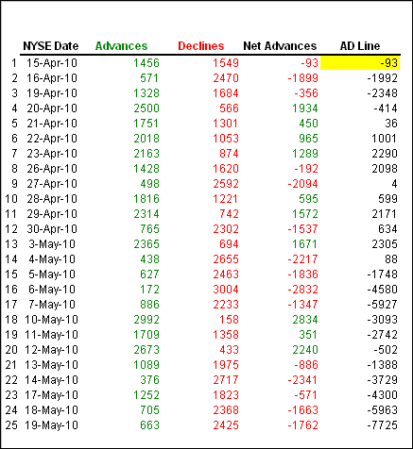
Market indicators

Slide 79
Market indicators
TRIN or Short-Term TRading Index - The index is calculated by dividing the AD Ratio by the AD Volume Ratio. Typically, these breadth statistics are derived from NYSE or Nasdaq data, but the Arms Index can be calculated using breadth statistics from other indices such as the S&P 500 or Nasdaq 100. Because it acts as an oscillator, the indicator is often used to identify short-term overbought and oversold situations.

Slide 80
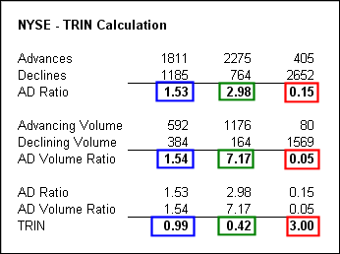
Market indicators

Slide 81
Sentiment Indicators
Opinion Polls: Positive sentiment of profession analyst is expected to indicate bullish market in days to come, and vice versa.
Pull/Call Ratio: High put call ratio reflects bearish market ahead
Margin Debt Ratio: Higher margin ratio means higher buying activity , hence positive market sentiment ahead.
Short Interest Ratio: It is effective short position of a share relative to daily trading volume . Higher ratio means investors are bearish on the prospect of that security.
Mutual Fund Cash Position: High cash position means higher buying power , or may be fund managers are bearish on market outlook.
New Equity Issuance: More new equity issue indicates market is almost near the top .
Secondary Offering ( sale by sponsor directors / offloading of strategic investors in the secondary market) : Like IPO, effective supply of security may increase , hence may have negative effect on price.

Slide 82
Technical screens
  Small stock screens
  Neglected stocks screens
  Seasonal screens
  Momentum screens
  Contrarian screens
  Insider trading screens

Slide 83
Technical analysis – caveats
We need to follow the volume as well not just the price.
History may repeat but we do not know when it will be repeated.
It is difficult to pick up a pattern since investors are also part of that.
Any indicator with historical low or high is certainly indicating a reversal in trend.
There will be industry or firm wise adjustments while interpreting the indicators.

Slide 84
A full proof investment strategy
Step 1: Choose the underpriced stock - fundamental analysis.
Step 2: Wait for the best possible price for that stock – technical analysis
Step 3: Before purchase or sale discount the rumors, price sensitive information

Slide 85
Useful Websites
www.stockbangladesh.com
http://stockcharts.com/school/doku.php?id=chart_school

